Slide 1

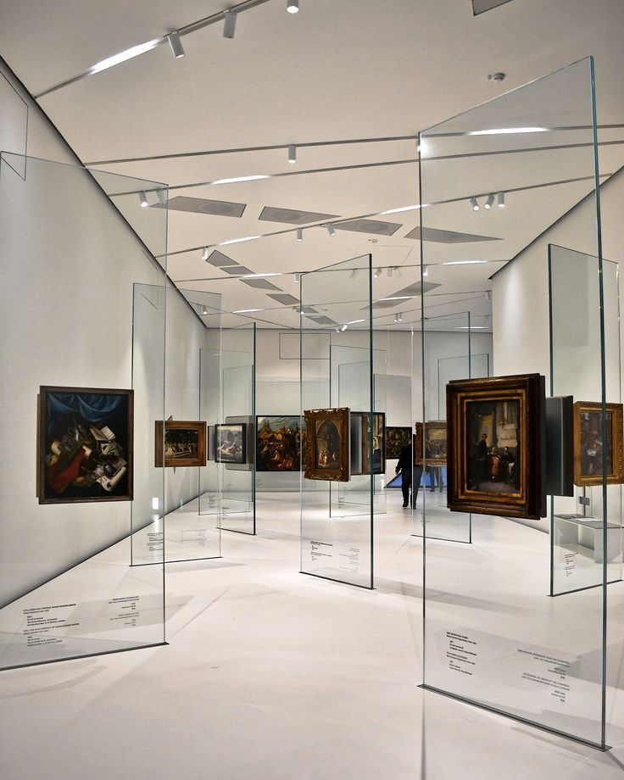

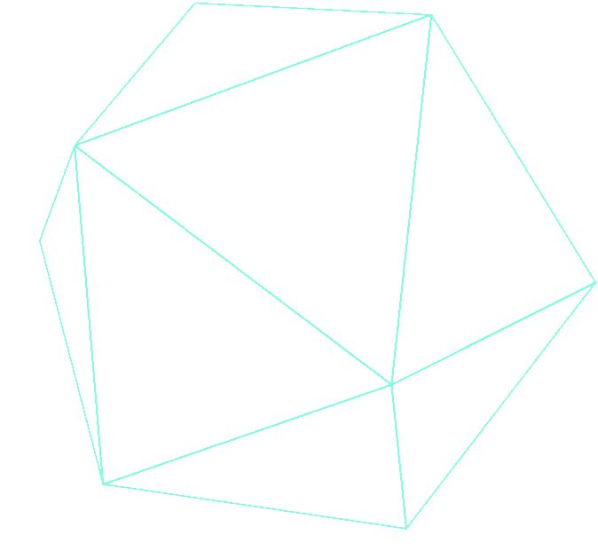
POLYGON
TRIANGULATION
GUARDING THE ART
GALLERY

Slide 2

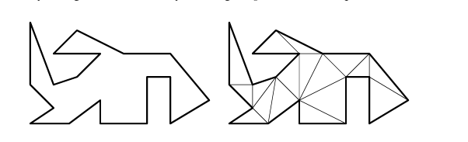
Problem Statement
Given a simple polygon P with ( n ) vertices representing the layout of an art gallery, we need to determine an optimal placement of cameras to ensure full visibility of the entire interior of the gallery.
A camera can see in all directions until their line of sight is blocked by an edge of the polygon.

Slide 3
Problem Understanding
Understanding the Problem Statement
1. Scenario:
• You have an art gallery, which can be represented as a polygon with multiple walls and corners.
• The goal is to monitor the entire gallery using a set of security cameras that can rotate.
2. Objective:
• You want to place the minimum number of cameras so that every part of the gallery (polygon)
is visible to at least one camera.
3. Constraints:
• Cameras are mounted on the ceiling and can rotate to cover different angles.
• The shape of the gallery (polygon) determines where cameras should be placed.
• The fewer the cameras, the better (to minimize cost and simplify monitoring).

Slide 4
Polygon Triangulation
Triangulation is the process of decomposing a polygon into non-overlapping triangles by adding non-intersecting diagonals.
The goal is to determine the minimum number of diagonals required to fully partition polygon into triangles.

Slide 5
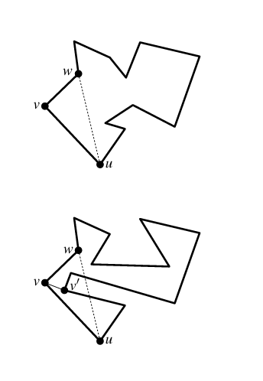
Diagonal Selection
Proof of Polygon Triangulation (Induction on n)
Base Case (n = 3):
A polygon with 3 vertices is a triangle, which is trivially triangulated.
2.Inductive Hypothesis:
Assume that any polygon with fewer than n vertices can be triangulated.
3.Existence of a Diagonal:
Let v be the leftmost vertex (or lowest in case of a tie).
Let u and w be its neighbors.
If segment uw lies inside P, it is a valid diagonal.
Otherwise, pick v' (the farthest vertex inside triangle uvw) and draw diagonal vv'.

Slide 6
Possible Solutions
solution-1:
Placing Cameras on Well-Chosen Diagonals:
Instead of placing one camera per triangle, placing them on strategic diagonals allows a single camera to guard multiple triangles, reducing the total count to approximately n/2 cameras.

Slide 7
Possible Solutions
solution-2:Vertex 3 colouring
USING DFS
A triangulated polygon can be 3-colored (vertices assigned white, gray, or black) using the dual graph and depth-first search (DFS).
Placing cameras at the vertices of the smallest color class ensures full visibility of the polygon.
A single color class covers at most n/3 vertices.
Thus, the polygon can always be guarded with at most n/3 cameras.

Slide 8
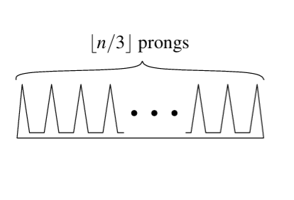
Worst-Case Comb-Shaped Polygon :
Polygon Structure:
A long horizontal base with n/3 vertical prongs, each formed by two edges, creating isolated regions.
Visibility Limitation:
Each prong blocks visibility to the next, preventing a single camera from covering multiple prongs.
Coloring Strategy:
Any triangulated polygon can be 3-colored, ensuring full coverage with at most n/3 cameras.
Optimal Camera Placement:
No strategy can use fewer than n/3 cameras, proving the Art Gallery Theorem.

Slide 9
Example illustration
Partitioning a Polygon into Monotone Pieces
Objective:
Efficiently partition a non-convex polygon P with n vertices into simpler pieces (y-monotone pieces) to aid in faster triangulation.
What is a Convex Polygon?
A convex polygon is a polygon in which all interior angles are less than 180°, and any line segment connecting two points inside the polygon lies entirely within the polygon
Why Monotone Pieces?
Triangulating convex polygons is easy (takes O(n) time).
Decomposing P into convex pieces is as hard as triangulating it, so we instead decompose it into y-monotone pieces, which can be efficiently triangulated.
A y-monotone polygon has the property that any vertical line intersects it in at most one connected segment.

Slide 10
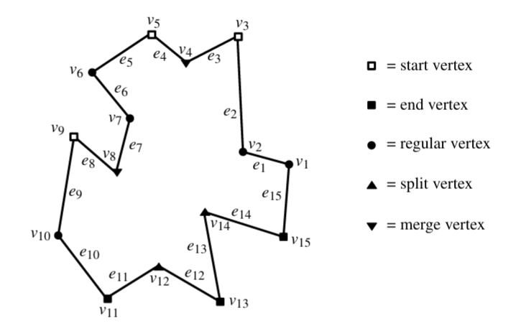
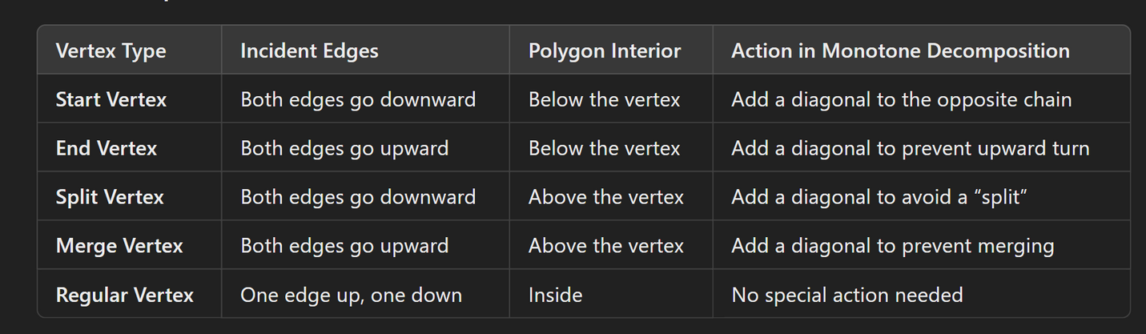
Types of polygon vertices

Slide 11
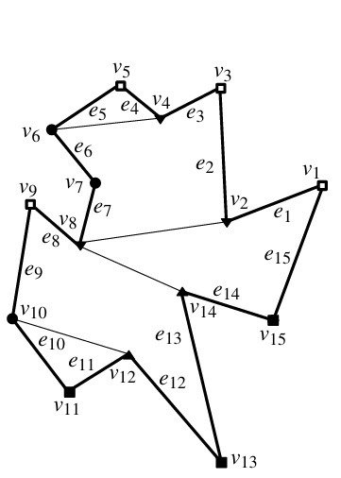
Conversion to Y-monotone
1. Handling Split Vertices
We connect each split vertex* to the lowest vertex above it.
This ensures the region is connected from top to bottom.
2. Handling Merge Vertices
We connect each merge vertex to the highest vertex below it.
This prevents merging disconnected lower components.

Slide 12
Algorithm:
PolygonTriangulation(P)
1. Call MakeMonotone(P) to get monotone subpolygons and vertex classifications.
2. Initialize empty list diagonals.
3. For each monotone subpolygon in the list:
a. Call TriangulateMonotonePolygon(subpolygon) and extend diagonals.
4. Return diagonals and vertex classifications.
ComputeCameras(P, diagonals)
1. Let vertices ← set of all vertices in P.
2. For each diagonal (u, v) in diagonals:
a. Remove u and v from vertices.
3. Let cameraPositions ← remaining vertices in vertices.
4. Return len(cameraPositions) and cameraPositions.

Slide 13
Algorithm:
MakeMonotone(P)
Construct a priority queue 𝒬 on the vertices of 𝓟, using their y-coordinates as priority. If two points have the same y-coordinate, the one with the smaller x-coordinate has higher priority.
2. Initialize an empty binary search tree 𝒯 (status structure).
3.Initialize an empty dictionary vertexTypes.
4.Initialize an empty list subpolygons.
5.While 𝒬 is not empty:
a. Remove the vertex vᵢ with the highest priority from 𝒬.
b. Classify the vertex vᵢ using ClassifyVertex(𝓟, i) and store the result in vertexTypes.
c. Call the handling function to handle vᵢ, depending on its type.
6.Return 𝒟 (partitioned monotone subpolygons) and vertexTypes.

Slide 14
Algorithm:
ClassifyVertex(P, i)
1. Let prev ← P[i-1], curr ← P[i], next ← P[(i+1) % len(P)]
2. If curr.y > prev.y and curr.y > next.y:
a. If Orientation(prev, curr, next) < 0:
Return "Start Vertex"
b. Else:
Return "Split Vertex"
3. Else if curr.y < prev.y and curr.y < next.y:
a. If Orientation(prev, curr, next) < 0:
Return "End Vertex"
b. Else:
Return "Merge Vertex"
4. Else:
Return "Regular Vertex"

Slide 15
Algorithm:
Orientation(p, q, r)
1. Compute val ← (q.y - p.y) * (r.x - q.x) - (q.x - p.x) * (r.y - q.y)
2. If val == 0:
Return 0 // Collinear
3. Else if val > 0:
Return 1 // Clockwise
4. Else:
Return -1 // Counterclockwise

Slide 16
Algorithm:
TriangulateMonotonePolygon(monotonePolygon)
1. Sort vertices of monotonePolygon in decreasing order of y-coordinate.
2. Initialize stack with first two vertices.
3. Initialize empty list diagonals.
4. For i from 2 to len(vertices) - 1:
a. While stack has at least 2 vertices:
i. Let top ← stack[-1], prev ← stack[-2].
ii. If Orientation(prev, top, vertices[i]) = -1:
Append diagonal (top, vertices[i]) to diagonals.
Pop top from stack.
iii. Else:
Break loop.
b. Push vertices[i] onto stack.
5. Return diagonals.

Slide 17
TIME COMPLEXITY
Overall Complexity
1.Partitioning into Monotone: 0(n 1og n)
2.Triangulating Monotone Pieces: 0(n 1og n)
3.Camera Placement: 0(n)
Total: 0(n 1og n)

Slide 18
TIME COMPLEXITY
Partitioning into Monotone Polygons ( make_monotone() )
Key Steps:
1. Vertex Classification:
Classify each vertex as start/end/split/merge/regular.
Time: 0(n) (each vertex processed once).
2. Event Queue Construction:
Sort vertices by descending y (and x for ties).
Time: O(n log n) (priority queue/heap construction).
3. Sweep Line Algorithm:
For each vertex, perform BST operations:
Insertion/Deletion: 0(1og n) per operation.
Left Neighbor Query: 0(1og n) per query.
Total Events: 0(n) vertices processed
Total Time: 0(n 1og n) -
Total Time: 0(n 1og n)

Slide 19
TIME COMPLEXITY
Triangulating Monotone Polygons (triangulate_monotone() )
Key Steps:
1. Sort Vertices by y:
Each monotone polygon has ≤ n vertices.
Time: 0(n log n) per polygon (but total vertices across all subpolygons is O(n) ).
2. Greedy Triangulation:
Process each vertex once, using a stack.
Time: 0(n) per monotone polygon.
Total Time:
Worst Case: 0(n log n) (if one polygon needs full sorting).

Slide 20
TIME COMPLEXITY
Camera Placement ( compute_cameras () )
1. Graph Construction:
• Build the dual graph of the triangulation (tree structure).
• Time: 0(n) .
2. Coloring the Dual Graph:
• DFS traversal of the dual graph.
• Time: 0(n) •
3. Selecting the Smallest Color Class:
• Count vertices per color.
• Time: 0(n) .
Total Time: 0(n)
(Dominated by graph traversal.)

Slide 21
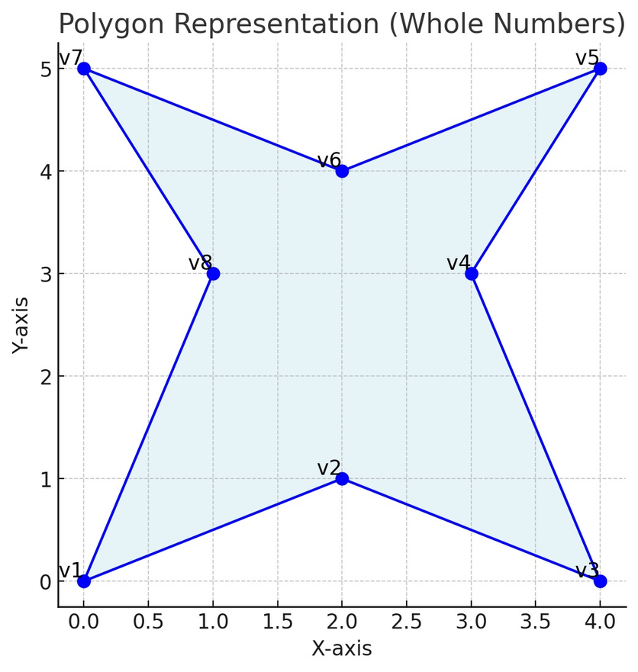
Code

Slide 22
Applications
Security Surveillance:
Optimal camera placement in museums, warehouses, and buildings.
Robotics:
Ensuring full visibility for robot navigation.
Computer Graphics:
Polygon triangulation for rendering and mesh generation.
Geographical Information Systems(GIS):
Decomposing complex regions for analysis.

Slide 23
Thank You
presented by
CB.SC.U4CSE23520
CB.SC.U4CSE23537
CB.SC.U4CSE23542
CB.SC.U4CSE23566

